Slide 1

Sales Analysis of Stores 10 & 21
IMT 577B
Pod 3 - Jwala, Renuka & Yash

Slide 2
01
02
OVERALL ASSESSMENT OF STORES 10 & 21
BONUS ALLOCATION
TABLE OF CONTENTS
03
04
DAILY SALES TRENDS
STORE EXPANSION

Slide 3
01 OVERALL ASSESSMENT OF STORES 10 & 21

Slide 4
How are stores 10 & 21 performing compared to their target? Will they meet their 2014 target?

Slide 5
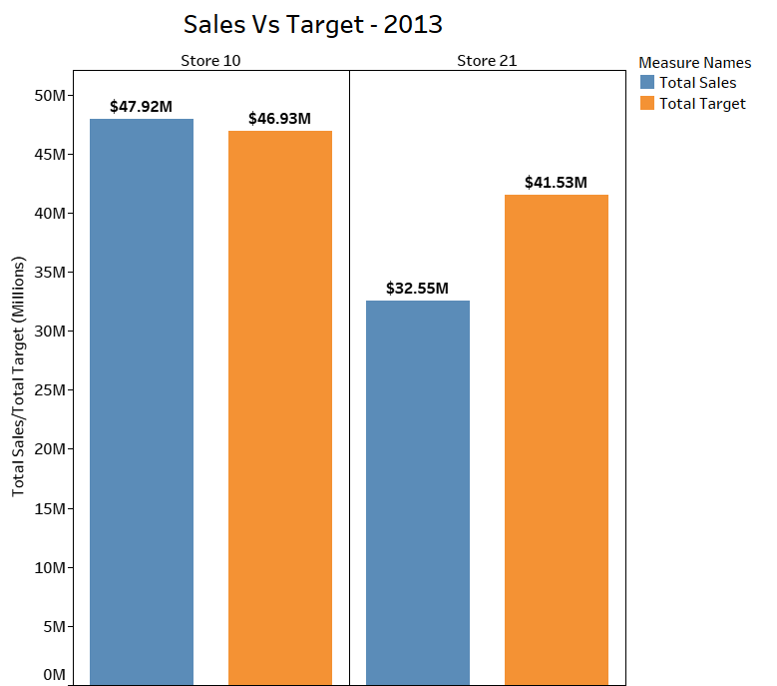
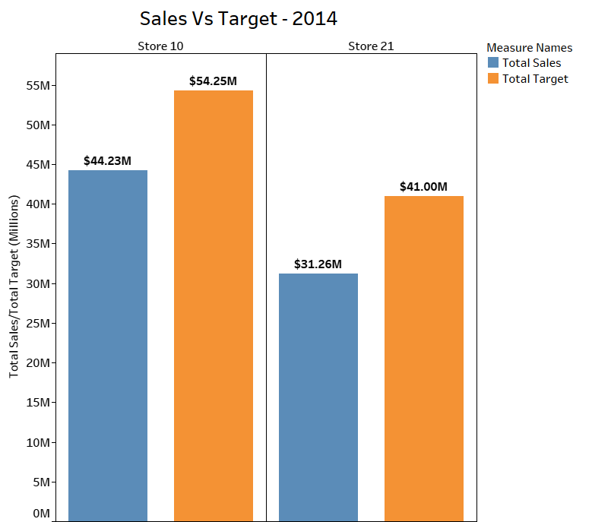
Actual store sales vs. target sales
Note:
The 2014 sales data are only till October but the target is for the entire year
2013
2014

Slide 6
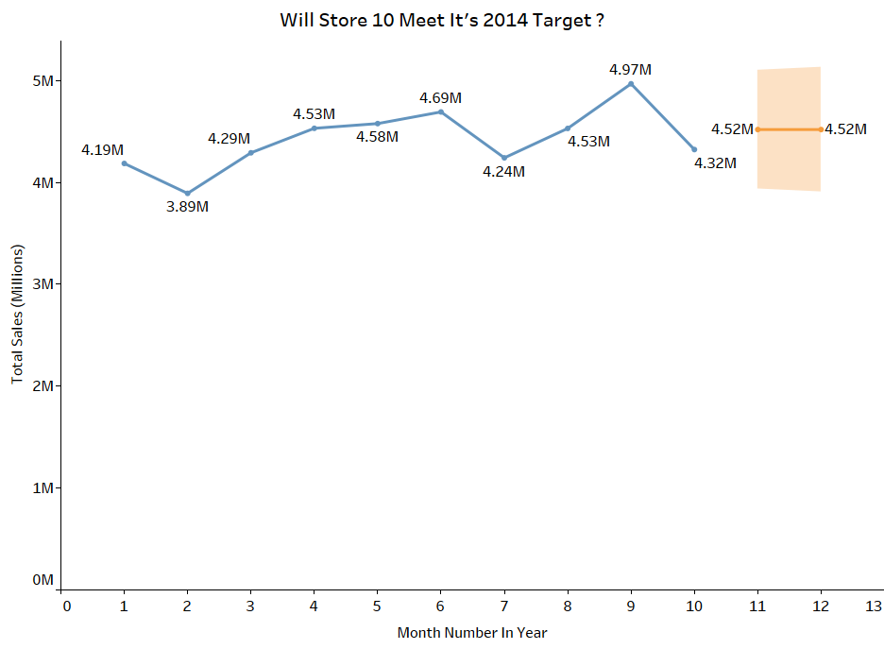
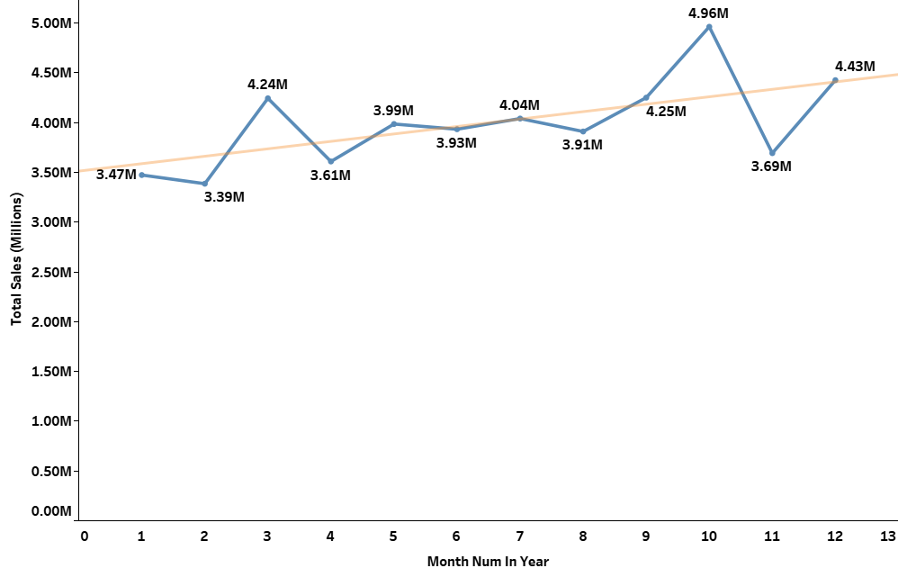
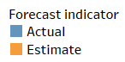
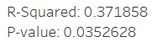
Will store 10 meet its 2014 target?
Trend line
2014 sales forecast
2013 monthly sales trend
Total sales till October: $44.23M
Annual target: $54.25M
Forecast for Nov & Dec: $9.04M
Missing 2014 sales target by $0.98M
Strong sales in 2013 with an upwards monthly trend
Nov & Dec have higher than average sales (holiday season)
Target is achievable!

Slide 7
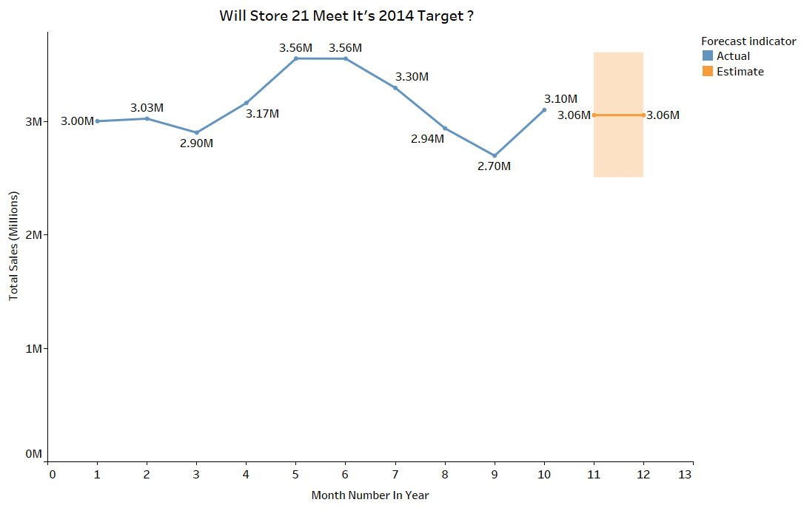
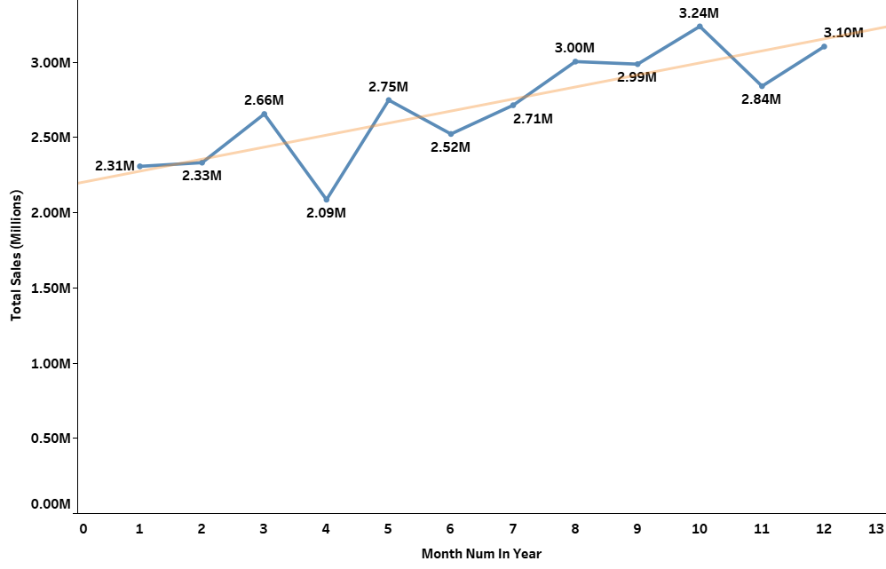
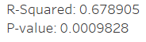
Will store 21 meet its 2014 target?
Trend line
2014 sales forecast
2013 monthly sales trend
Total sales till October: $31.26M
Annual target: $41M
Forecast for Nov & Dec: $6.12M
Missing its sales target by $3.63M
Upwards sales trend; steeper than store 10
Nov & Dec have higher than average sales so additional $3.63M sales in 2 months could happen
Target may be achievable

Slide 8
Should either store be closed? Why or why not?

Slide 9
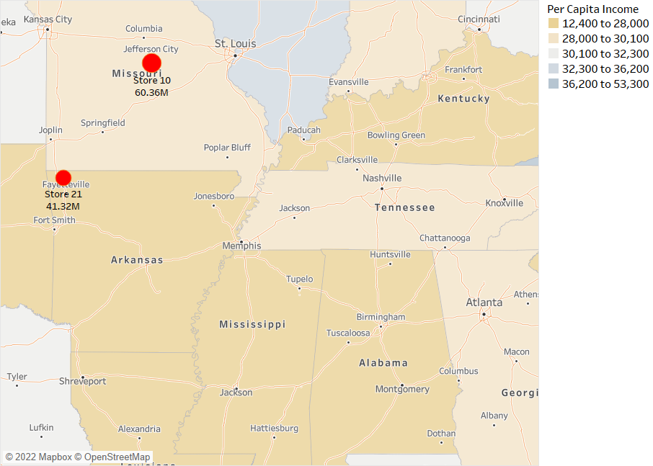
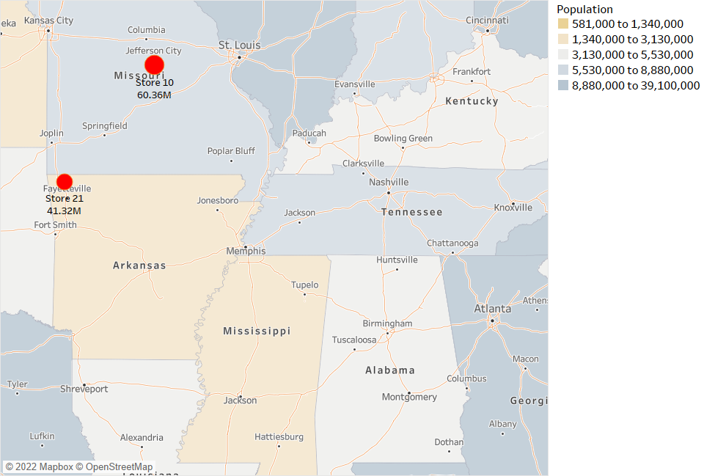
Store locations
By per capita income
By population
Store 10 - Low per capita income area
Store 21 - Lowest per capita income area
Store 10 - Moderately high population density area
Store 21 - Low population density area

Slide 10
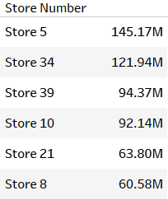
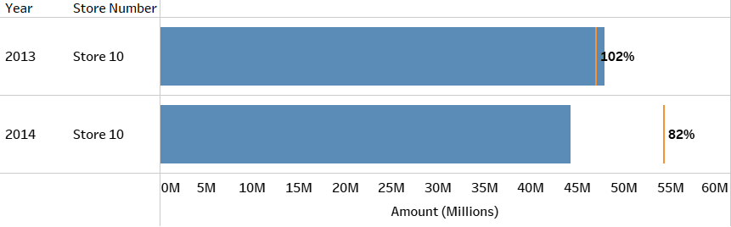
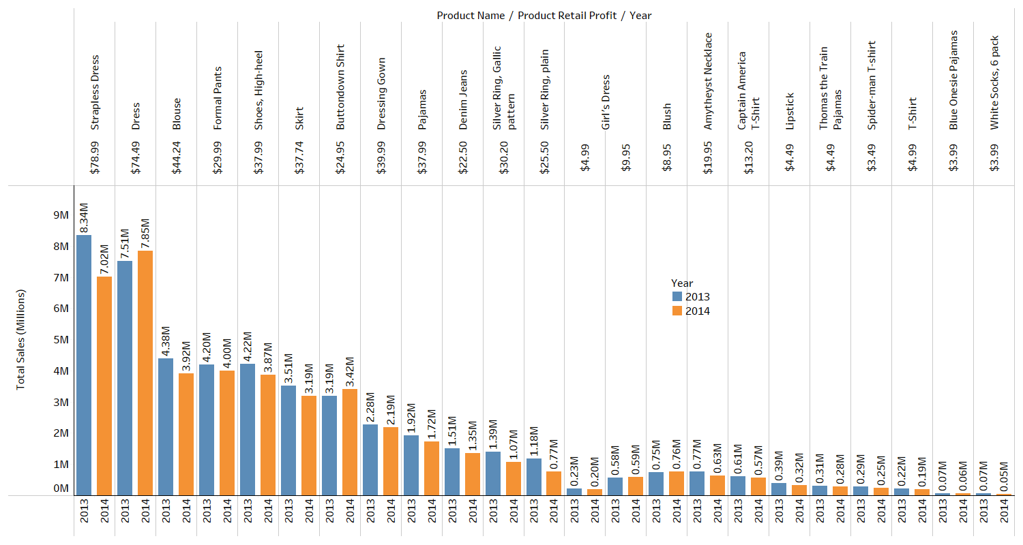
Store 10 closure
Total Sales (Millions)
Exceeded 2013 sales target by $0.98M
Need to achieve $10.2M in sales in Nov & Dec 2014 to meet the 2014 target
2014 target is achievable
Expected profit of $8.04M in 2014
Located in a high population density area with low per capita income
Recommendation: Definitely should not close store 10

Slide 11
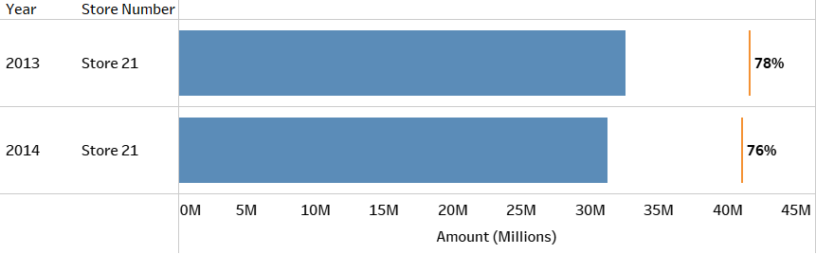
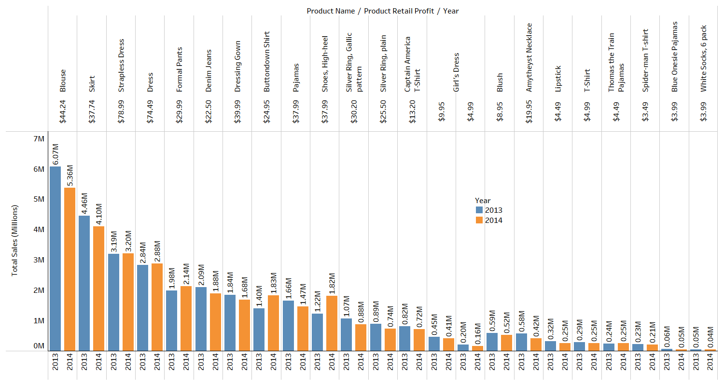
Store 21 closure
Total Sales (Millions)
Missed 2013 sales target by $8.98M
Need to achieve $9.74M in sales in Nov & Dec 2014 to meet the 2014 target
2014 target may be achievable
Expected profit of $2.49M in 2014
Located in a low population density area with lowest per capita income
Recommendation: Could consider closing store 21

Slide 12
What should be done in the next year to maximize store profits?

Slide 13
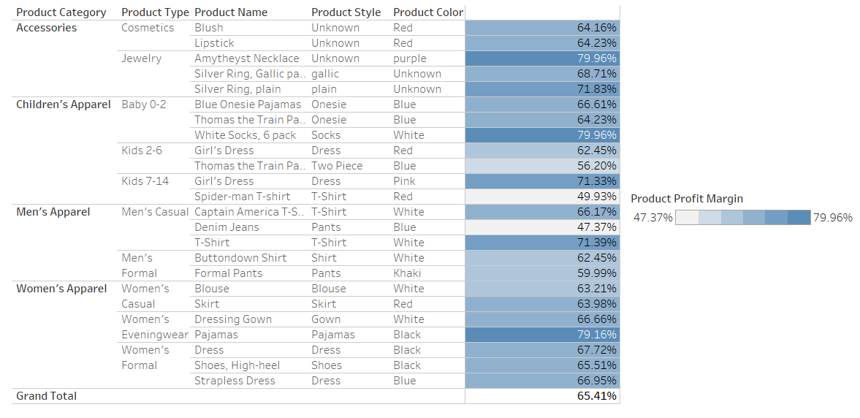
Profit margin of every product
Product Profit Margin
Products with highest profit margin
Amethyst Necklace (79.96%)
White Socks, 6 pack (79.96%)
Pajamas (79.16%)
Silver ring, plain (71.83%)
Men’s T-shirt (71.39%)

Slide 14
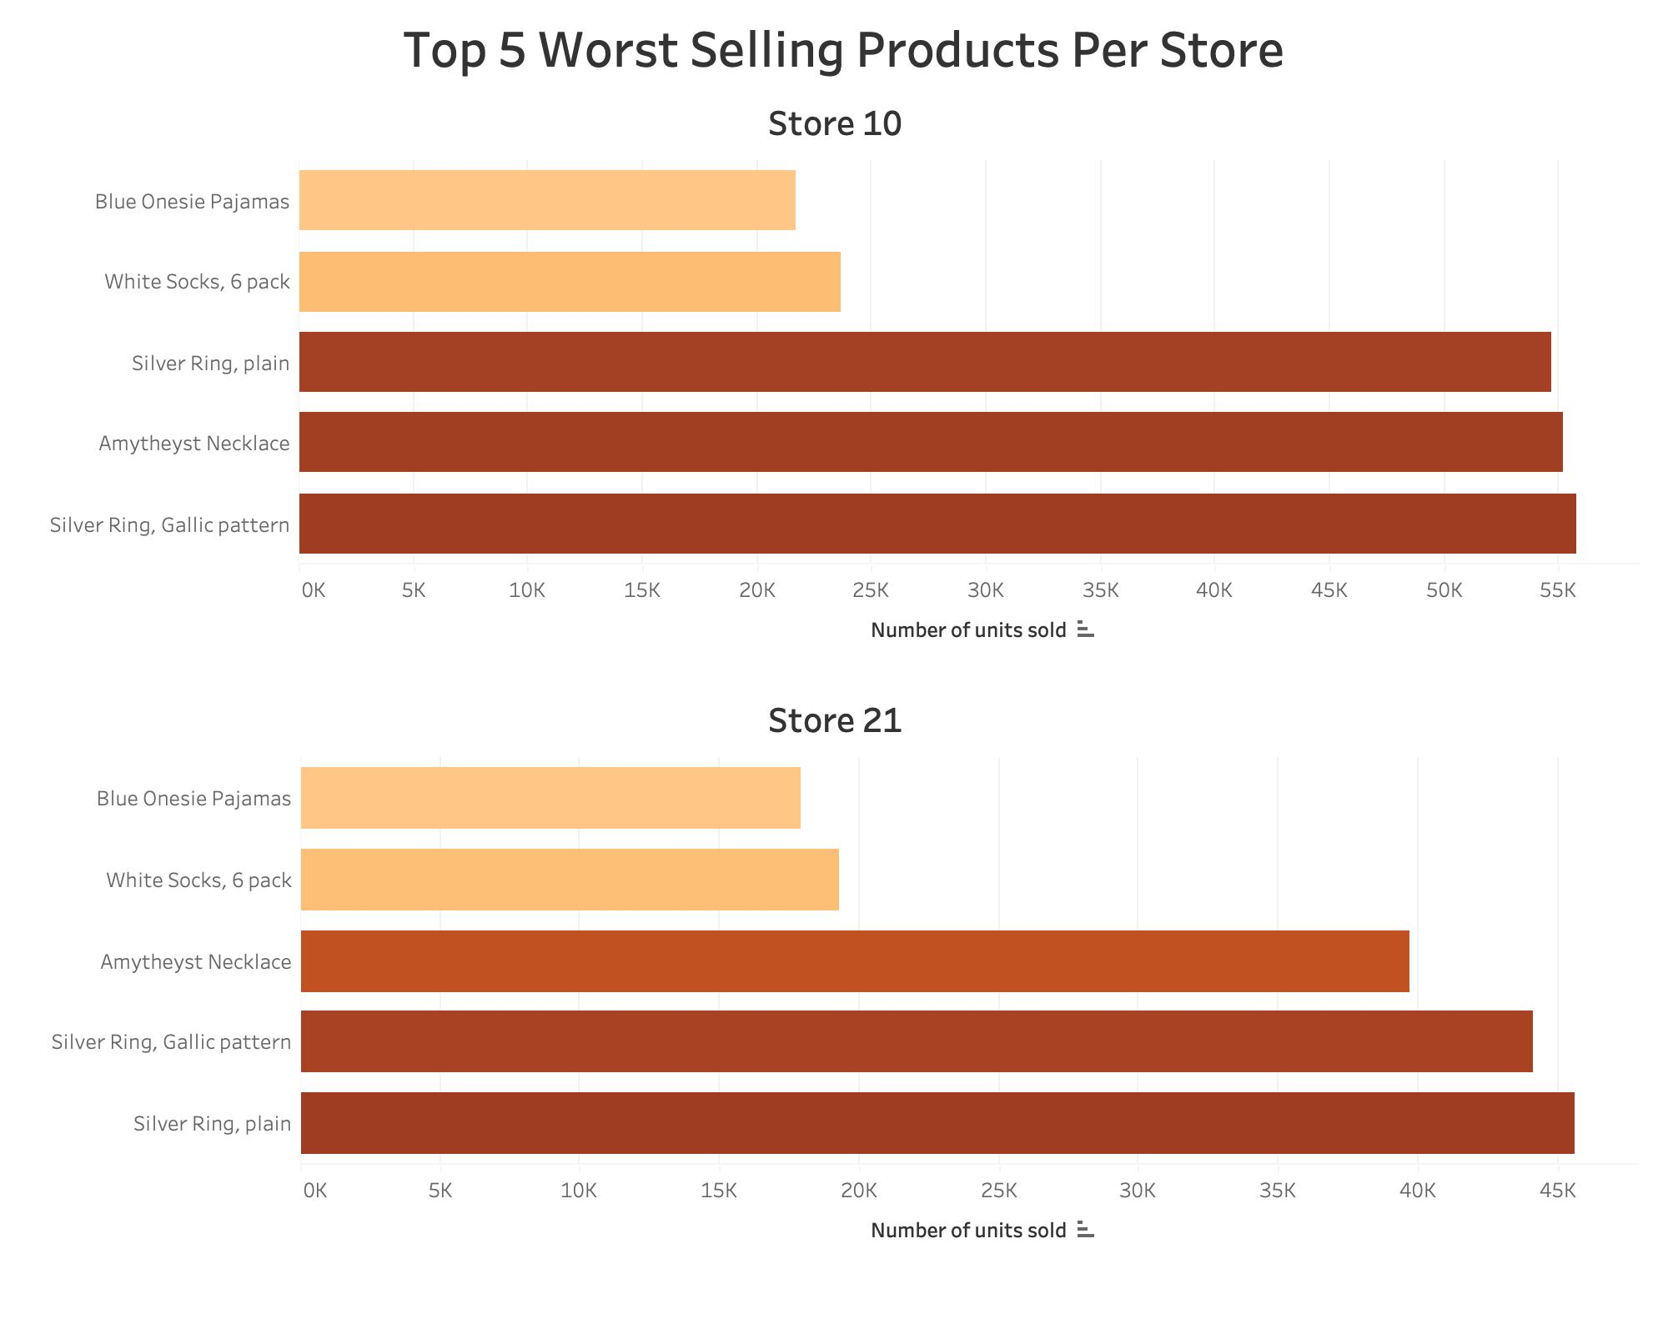
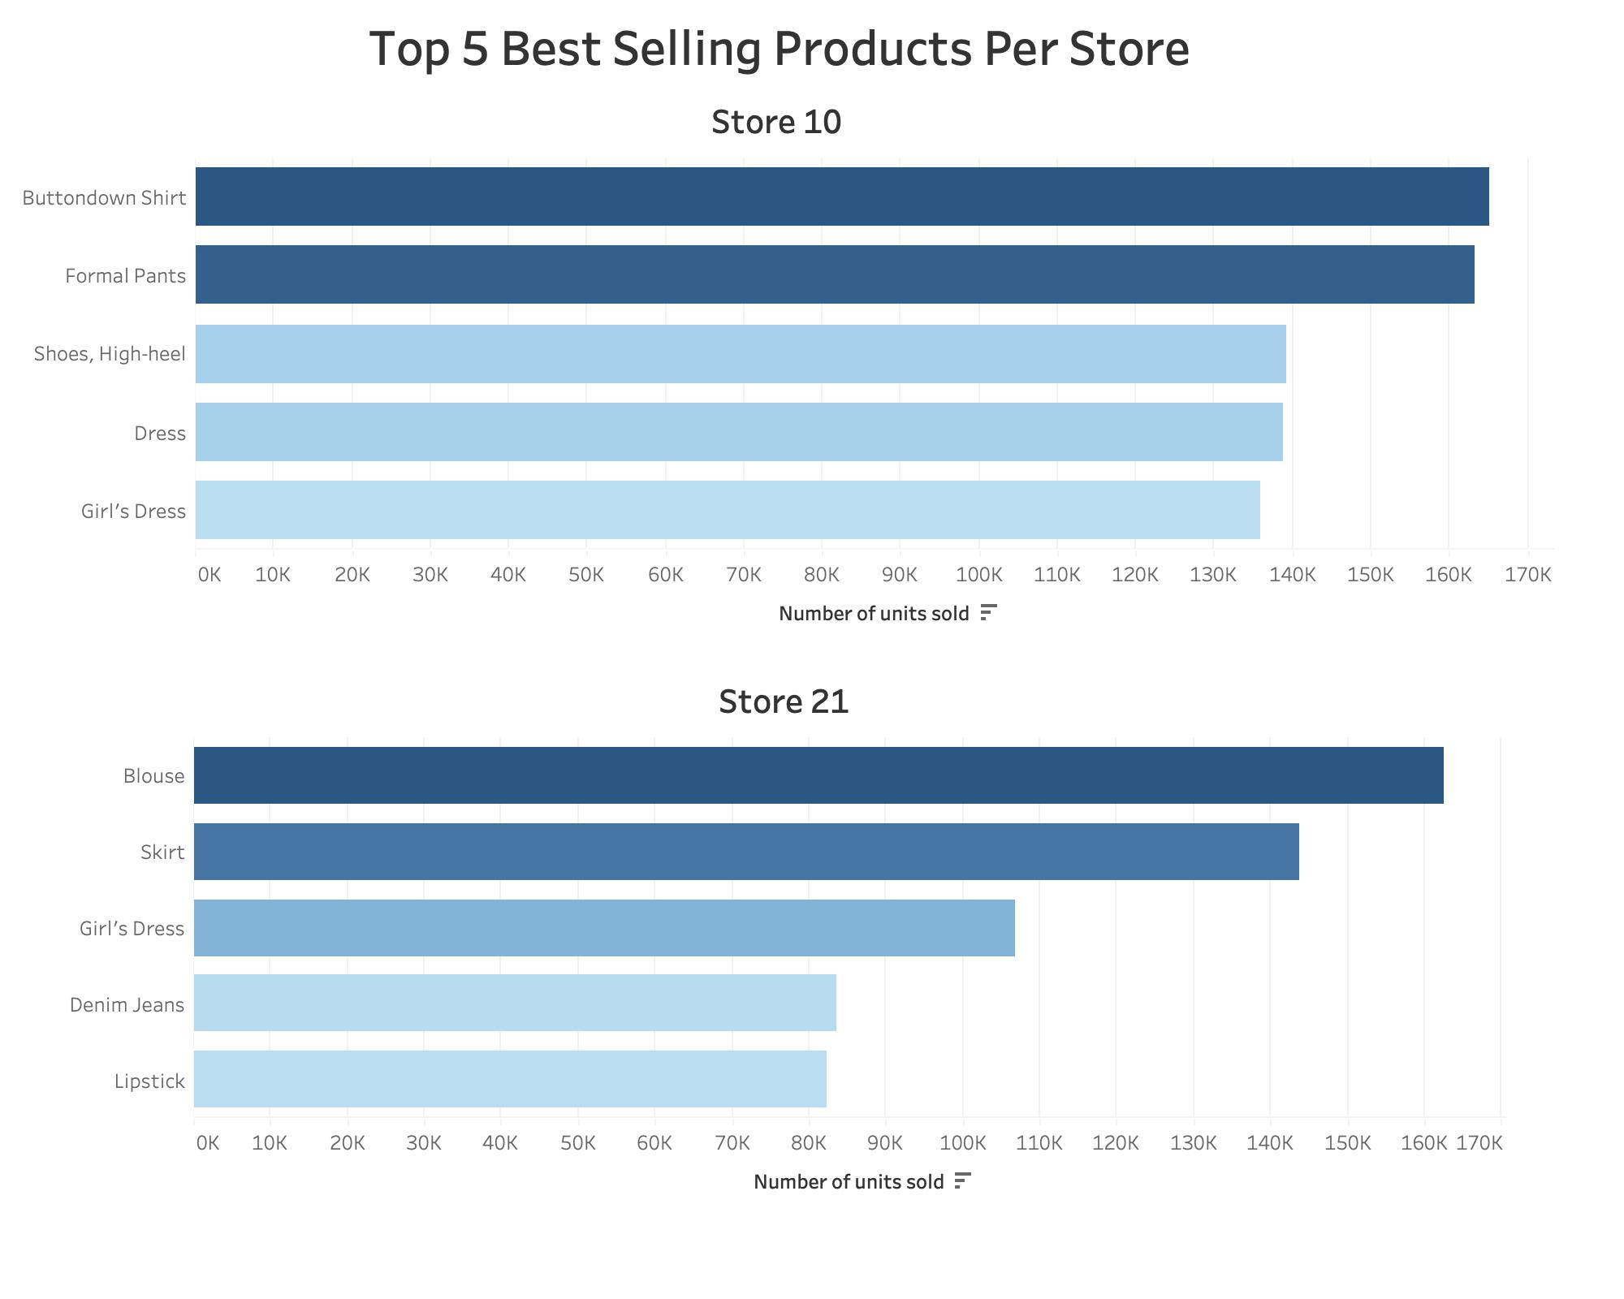
Top 5 worst & best selling products

Slide 15
Recommendations to maximize profits
Manufacture and sell more of the best selling products
Button-down shirt and formal pants in store 10
Blouse and skirt in store 21
Products with highest profit margin are worst sellers in both stores (amethyst necklace, white socks, plain silver ring)
Re-evaluate the product pricing
Offer promotions
Best selling products can be coupled with high margin products to be offered as promotions.
Offering bundle discounts or bulk discounts can maximize profits for high selling products, while boosting sales for low selling, highly profitable products
Product placement optimization
High-profit items need to be placed strategically near the check-out or other high traffic areas to maximize the likelihood of their sale

Slide 16
02 BONUS ALLOCATION OF $2 MILLION

Slide 17
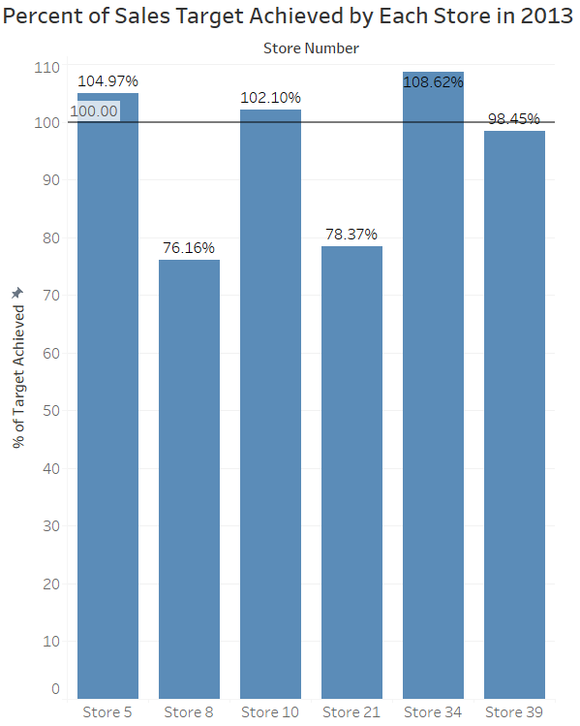
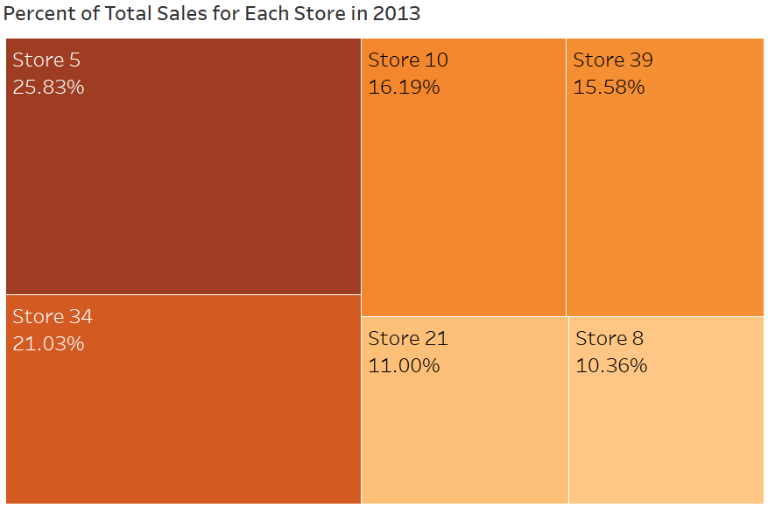
Calculating bonus allocation
Step 1: Calculate the sales contribution of every store
Step 2: Calculate the percent of 2013 target achieved by every store

Slide 18
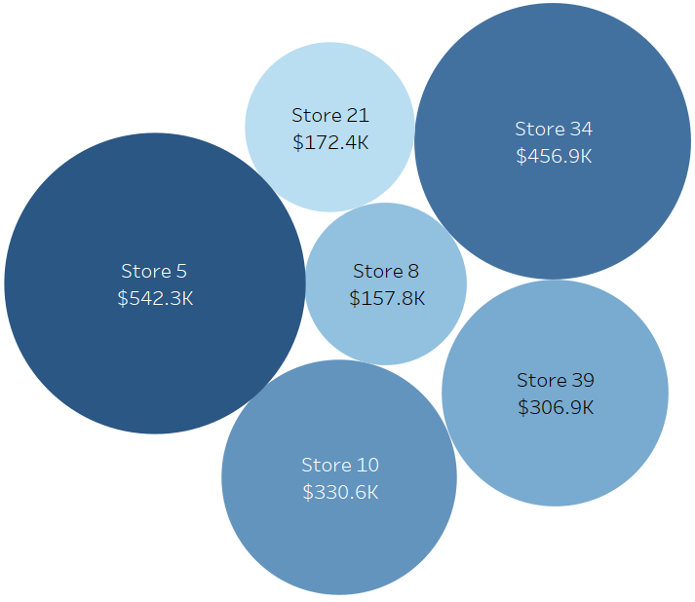
Dividing the $2M bonus
Store Number | Bonus Amount
Store 5 | $542,330
Store 34 | $456,928
Store 10 | $330,619
Store 39 | $306,883
Store 21 | $172,383
Store 8 | $157,828
Unearned bonus | $33,029
Total | $2,000,000
Step 3: Calculate bonus allocation for every store = $2M x % of sales contribution x % of target achieved

Slide 19
03 DAILY SALES TRENDS

Slide 20
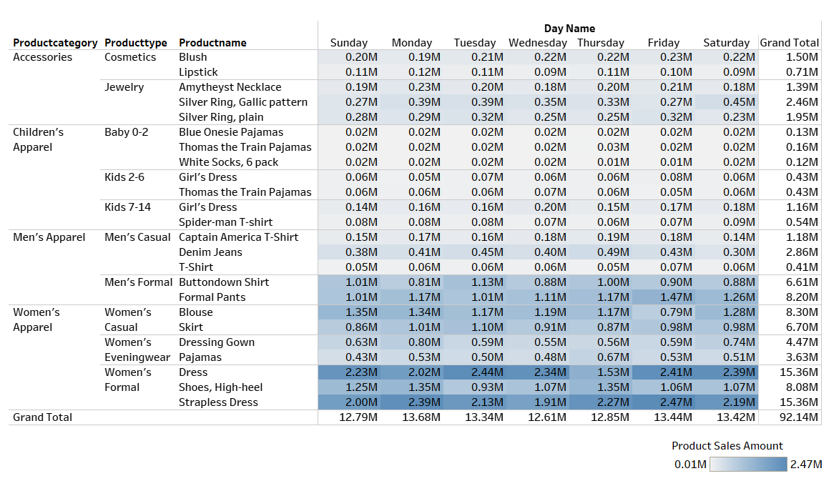
Store 10 - daily sales trends
Sales Amount:
Sales Quantity:

Slide 21
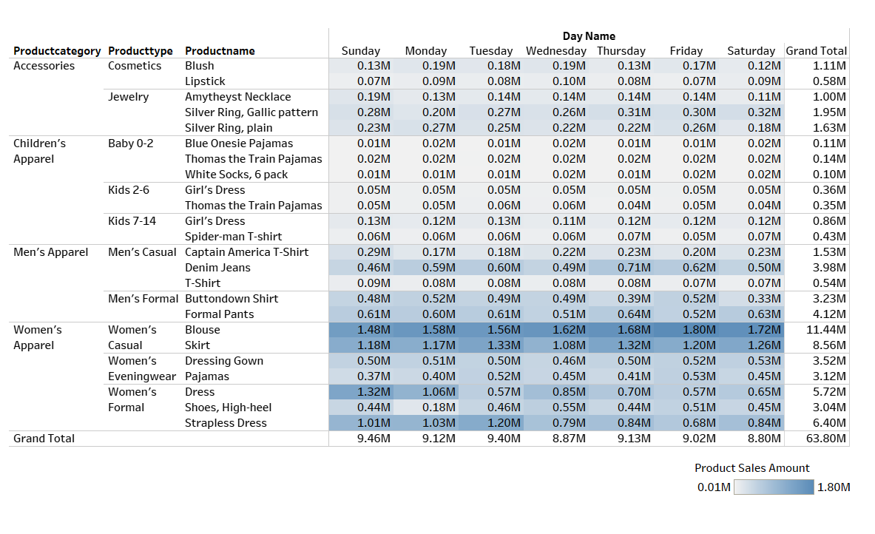
Store 21 - daily sales trends
Sales Amount:
Sales Quantity:

Slide 22
04 STORE EXPANSION

Slide 23
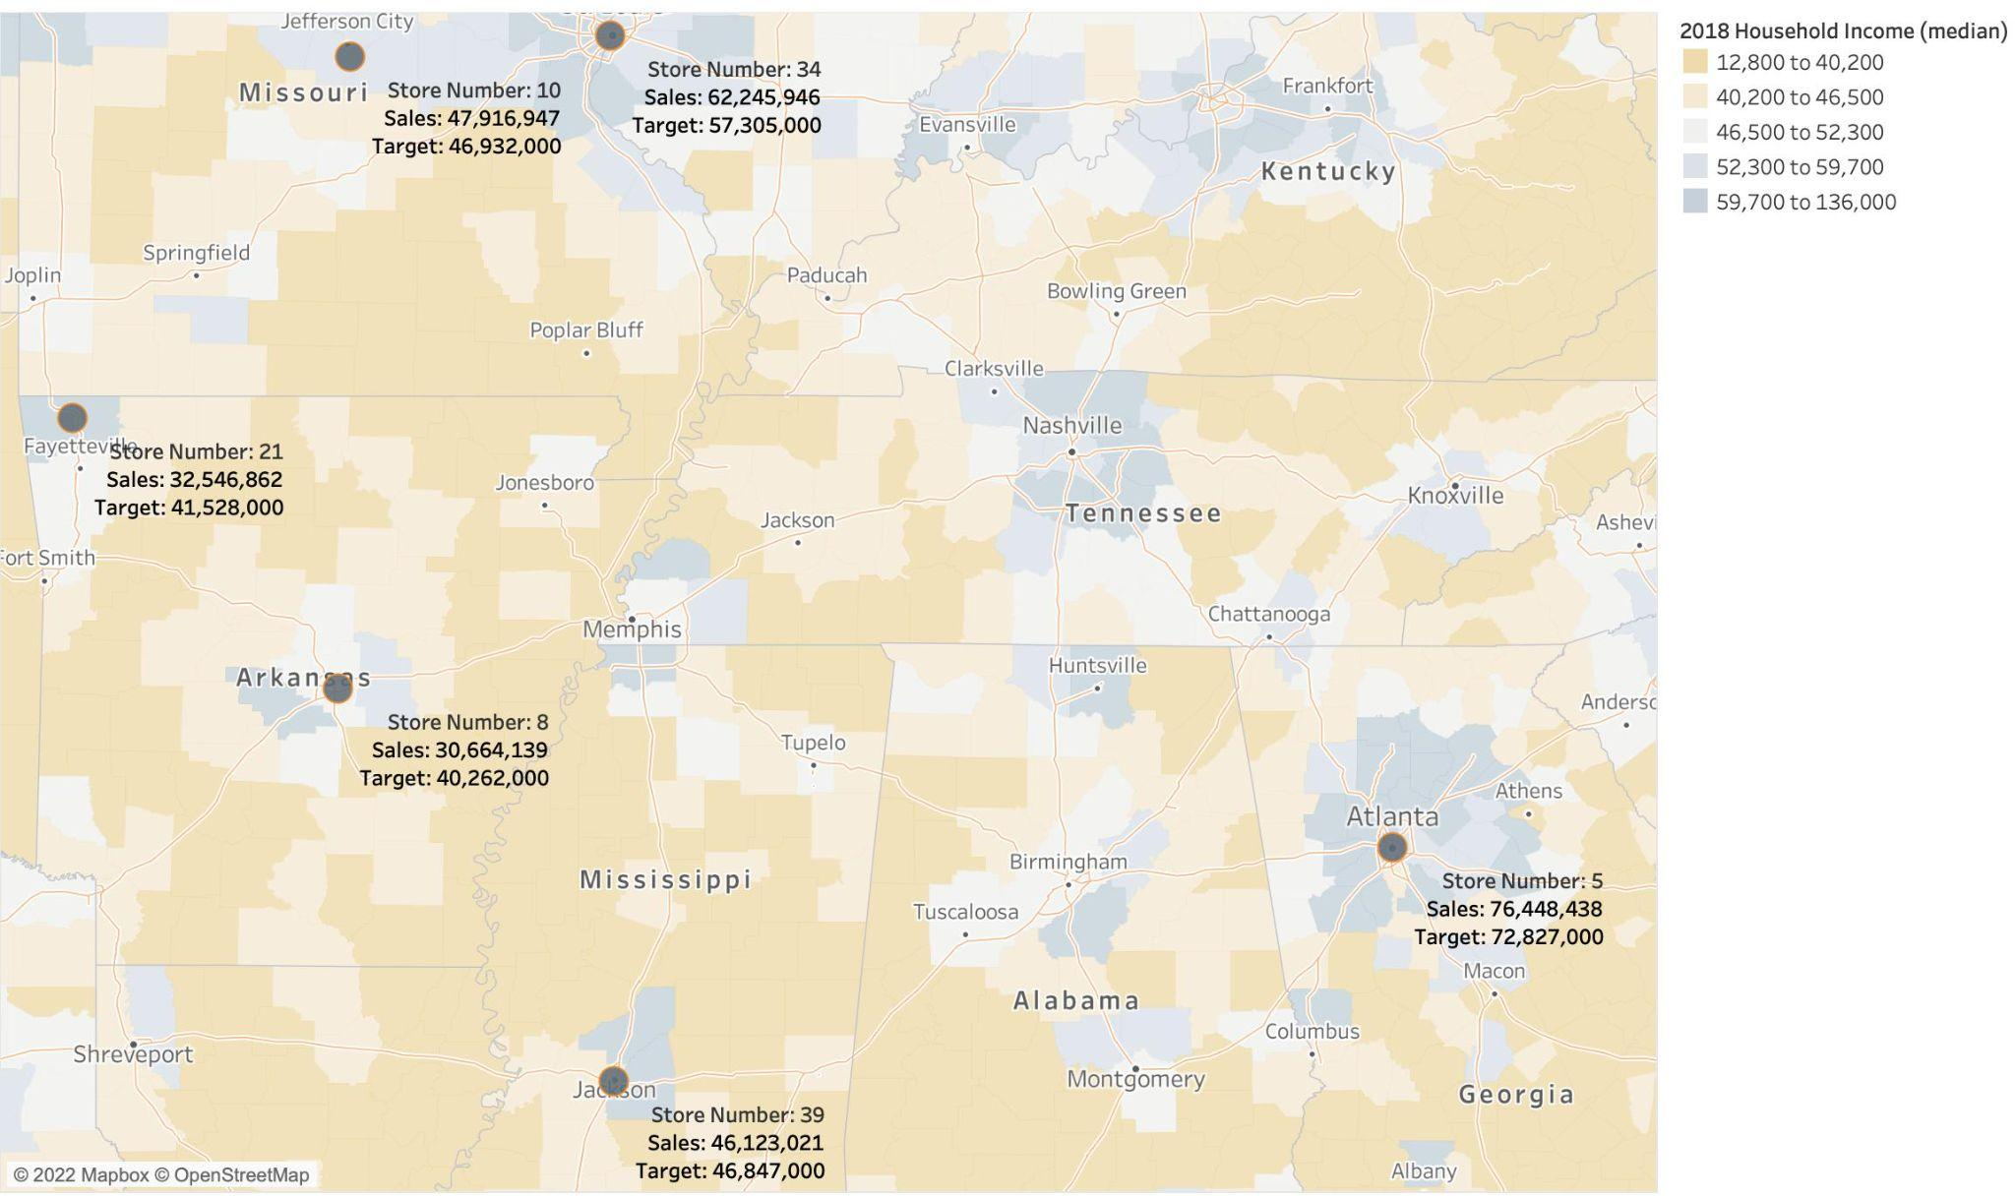
Geographical survey of store success
Stores that achieved their targets are:
in high income areas
connected to several US freeways
New stores should be created in high-income areas that are connected to major roadways
Suggested areas: Memphis, Nashville, Knoxville

Slide 24
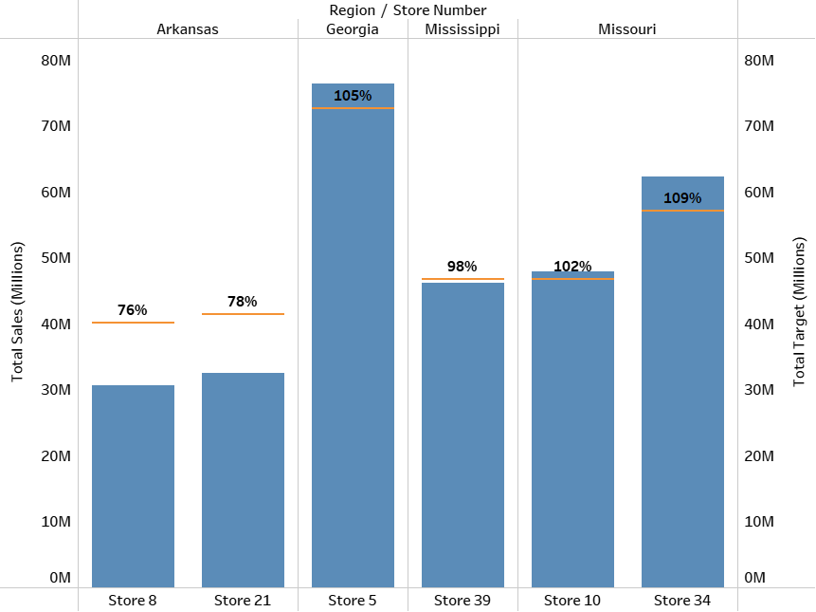
Regional store success
Both stores in Arkansas have underperforming stores
Missouri and Georgia - all stores have outperformed their targets
With similar attributes as Georgia, we recommend that a new store be opened in Nashville, Tennessee and a second store near Atlanta, Georgia

Slide 25
Thank
You!
CREDITS: This presentation template was created by Slidesgo, including icons by Flaticon and infographics & images by Freepik

